Slide 1
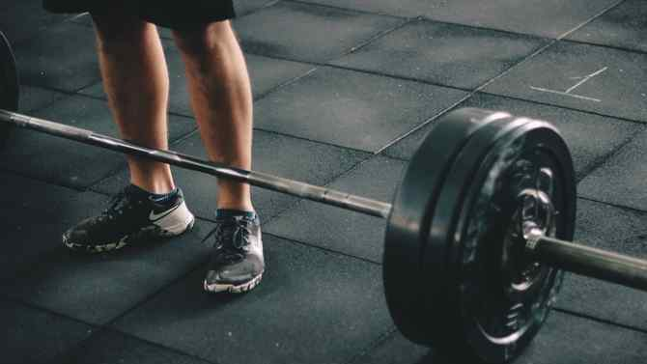
Track-Fitt Application
Bradley Stephenson
SD9
January 30^{th,} 2021
This Photo by Unknown Author is licensed under CC BY-ND

Slide 2
Background
Developing an all-in-one system to calculate your daily caloric needs, but also providing a functionality to input and track them throughout the day.
Providing user with an ease of access GUI to deliver an appealing and easy to use application that all users across the board can benefit from.
Color scheme will be red and black
Will start as a web desktop app, and eventually roll out mobile device compatibility.

Slide 3
Primary Objectives
Appealing, easy to use interface
BMR calculation ability
Personal profile
Access to data referring to different food and their calorie makeup(Carbs, Fats, Protein etc.…)

Slide 4
Types Of Data
Coded in C#
Personal account can be in application data(data managed and saved within the application)
BMR algorithm based on the Harris-Benedict Equation(most accurate)
Database access to different foods and their caloric make ups. Will have to access databases an tables to pull this information

Slide 5

Questions?/Comments?

